Slide 1
Carcharhinid Analysis
Final Project

Slide 2
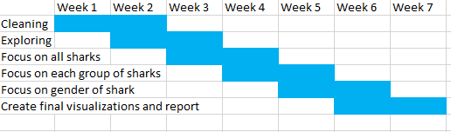
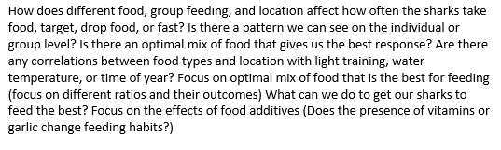
Work Breakdown Structure

Slide 4
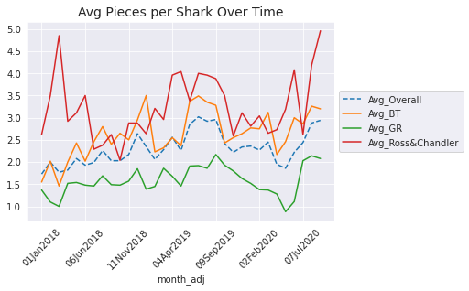

Slide 5
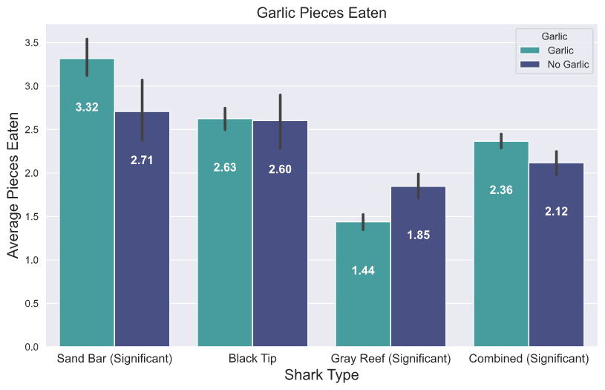

Slide 6
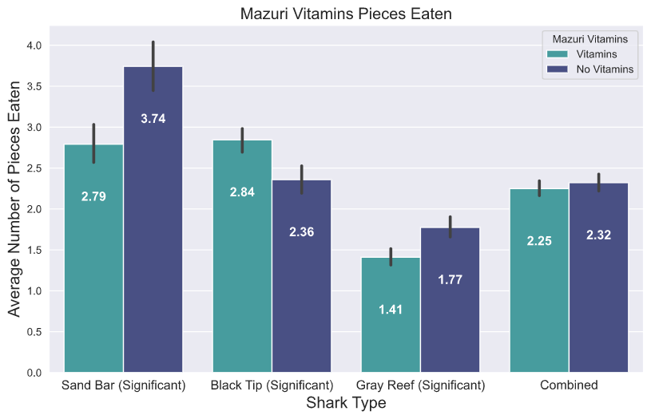

Slide 7
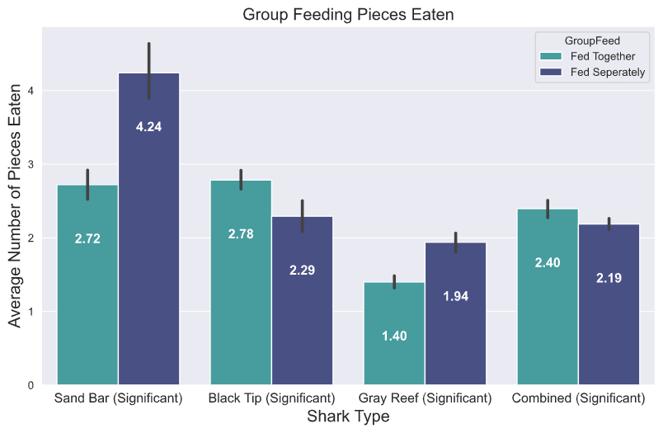

Slide 8
Black Tip

Slide 9
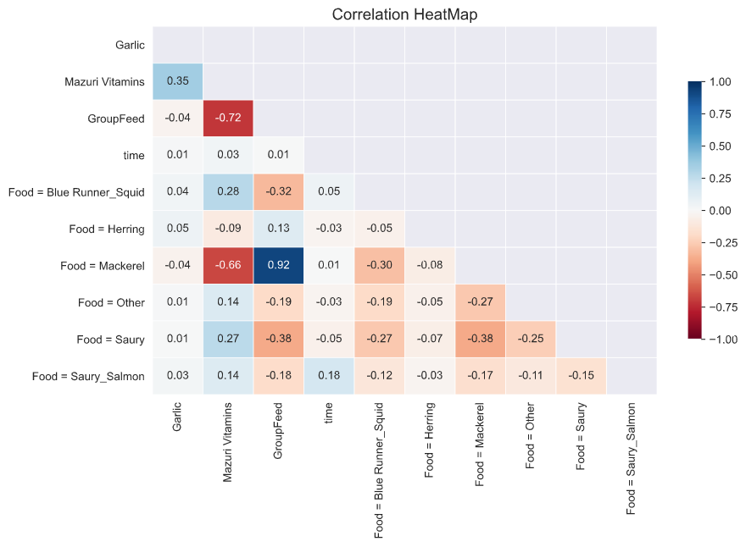
Black Tips
This Matrix shows how inter-related the variables were when analyzing the Black Tip’s feeding Trends.
The scale is from -1 to 1. The darker the box the more related the two variables were.
For example, Group Feeding and Vitamins have a strong negative correlation. Meaning that most of the time when They were fed together (0), they were also fed vitamins (1).

Slide 10
Average Food Eaten per Instance of top 3 food combos (Black Tips)

Slide 11
Individual Black Tip Avg Food per Instance (Top 3 Food Combos)

Slide 12
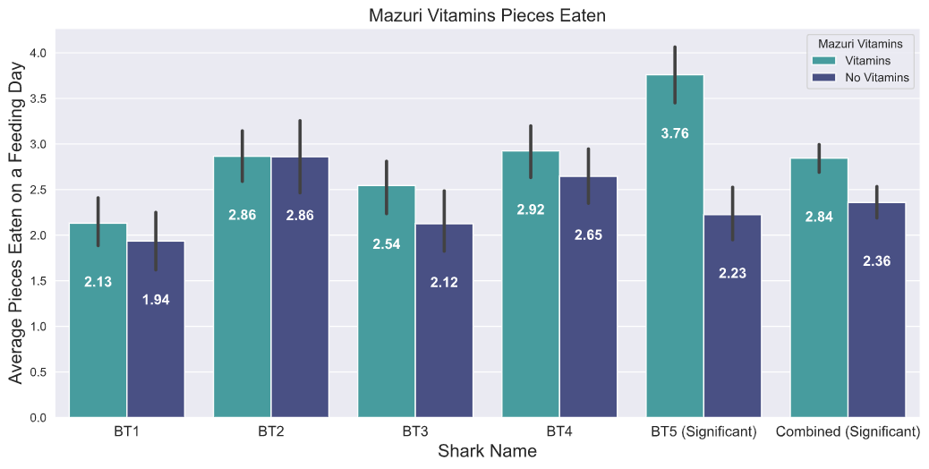
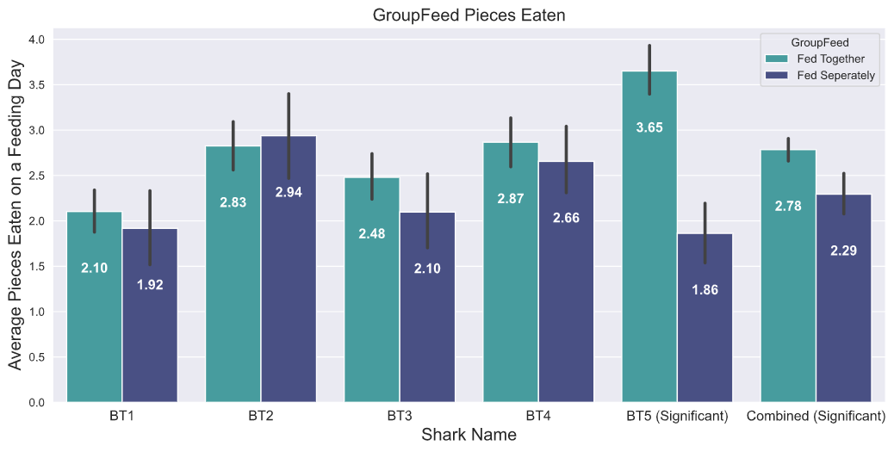
Black Tip Eating Patterns
While overall the presence of vitamins and Being fed with other sharks made the average amount eaten go up. It is mostly because BT5 eats much more during these times.
These two variables are hard to distinguish from each other because of the feeding patterns of the aquarium (See Correlation Matrix), so chances are BT5 eats more for because of either the presence of vitamins or being fed together.
Note: Significant under a group means that the averages were significantly different in a statistical t-test.

Slide 13
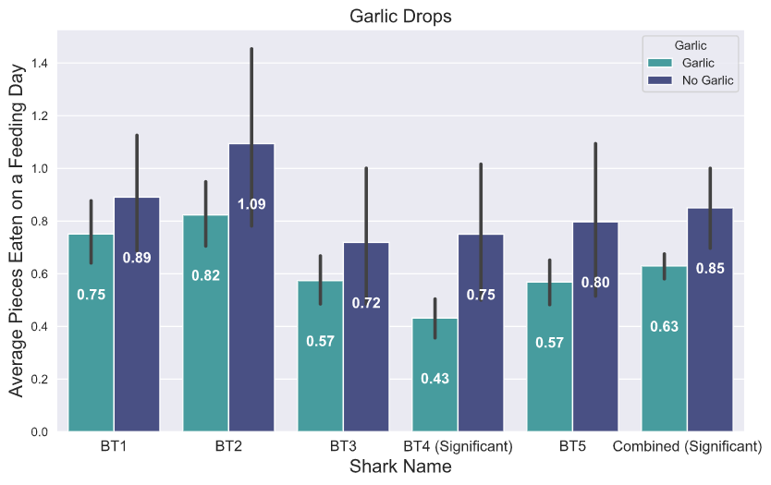
Black Tip Dropping Patterns
The only variable that seemed to affect the amount of food dropped was the presence of Garlic. Overall, the Black Tip dropped less when there was Garlic. This is very significant in shark BT4.
Note: Significant under a group means that the averages were significantly different in a statistical t-test.

Slide 14
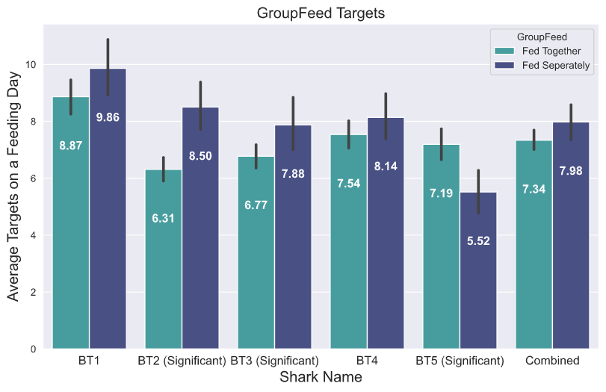
Black Tip Targeting Patterns
While being feed will certain sharks did not significantly affect the entire group. Three different sharks’ Targeting Patterns were strongly affected. BT5 is different from the rest as he targets more when they are being fed with other sharks.
Note: Significant under a group means that the averages were significantly different in a statistical t-test.

Slide 15
Individual Black Tip Feeding Summary
BT1 -
Favorite Food: Blue Runner with Squid
Didn’t show any clear preferences
BT2 -
Favorite Food: Blue Runner with Squid
Targeted more when they were being fed separately
BT3 -
Favorite Food: Blue Runner with Squid
Targeted more when Garlic was not present
Targeted more when they were fed separately
BT4 -
Favorite Food: Blue Runner with Squid
Dropped Less when garlic was present
BT5 -
Favorite Food: Blue Runner with Squid
Really likes either being fed together or vitamins

Slide 16
Gray Reef

Slide 17
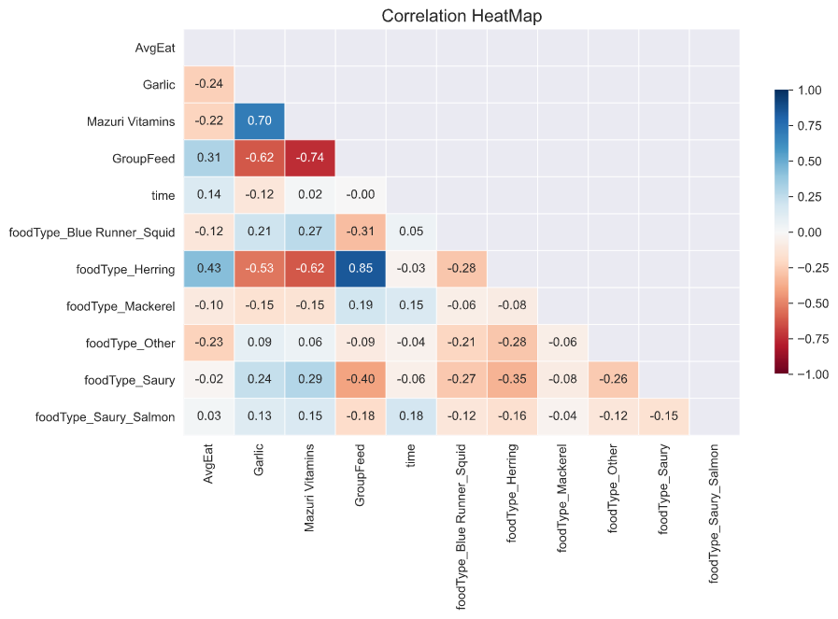
Gray Reefs
This Matrix shows how inter-related the variables were when analyzing the Gray Reef’s feeding trends.
The scale is from -1 to 1. The darker the box the more related the two variables were.
For example, Group Feeding and Vitamins have a strong negative correlation. Meaning that most of the time when They were fed together, they were also fed vitamins.

Slide 18
Average Food Eaten per Instance of top 3 food combos (Gray Reef)

Slide 19
Individual Gray Reef Avg Food per Instance (Top 3 Food Combos)

Slide 20
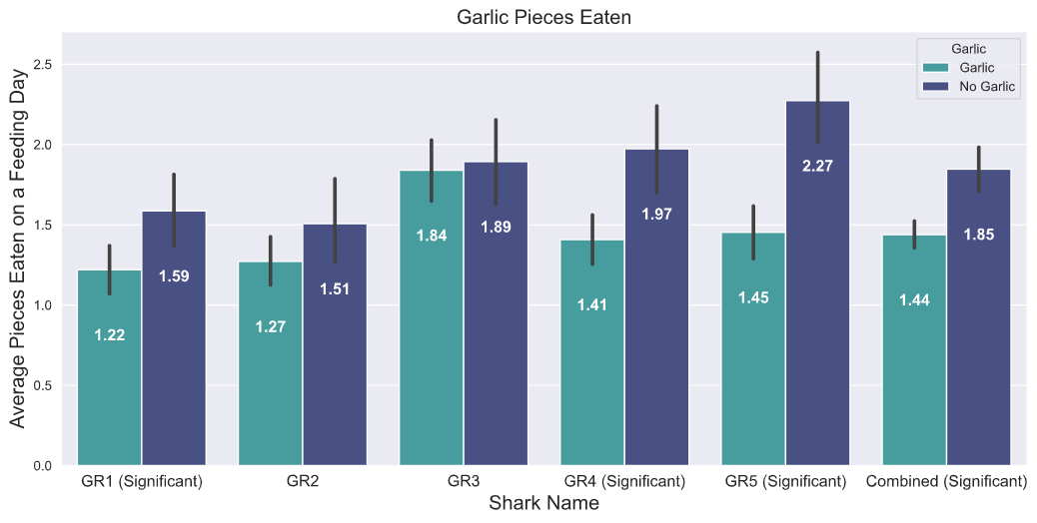
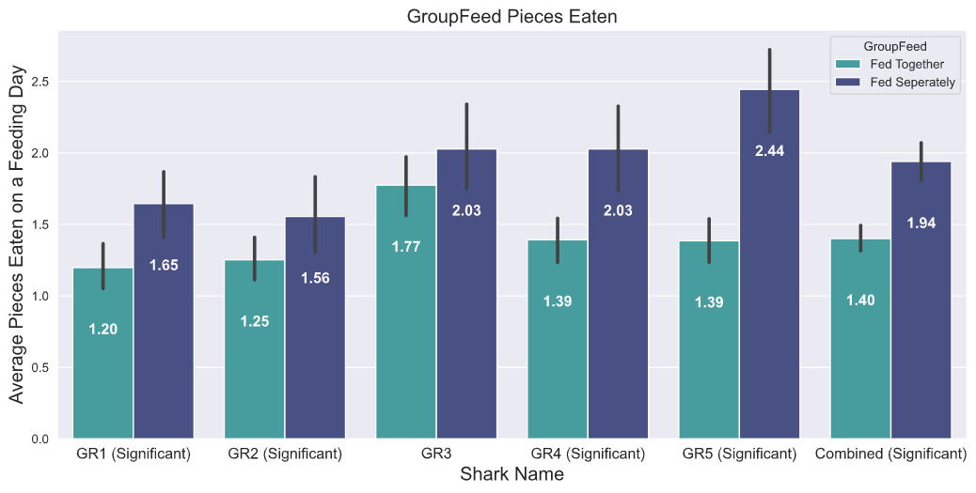
Gray Reef Eating Patterns
It is hard to determine exactly what the Gray Reef’s like and don’t like because Garlic, Group Feeding, and Vitamins are all strongly correlated. From the Graph we can see that they do like eating separately and food without Garlic.
Group Feeding tended to a little more significant than Garlic.
More feeding would have to be done in different way if we wanted clearer results.
Note: Significant under a group means that the averages were significantly different in a statistical t-test.

Slide 21
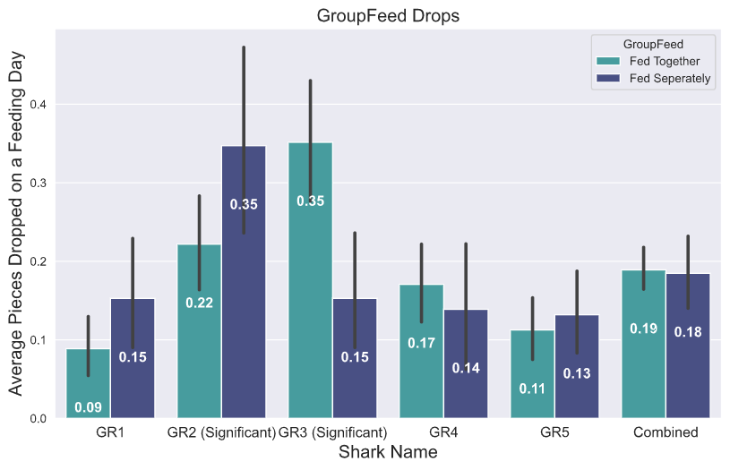
Gray Reef Dropping Patterns
Interestingly, GR2 drops more pieces of Food when they are fed separately, and GR3 is the opposite. She drops more food when they are fed together.
The presence of Vitamins was significant to GR3 but not GR2 and Garlic did not change the amount of food Dropped significantly. (Graphs in Appendix)
Note: Significant under a group means that the averages were significantly different in a statistical t-test.

Slide 22
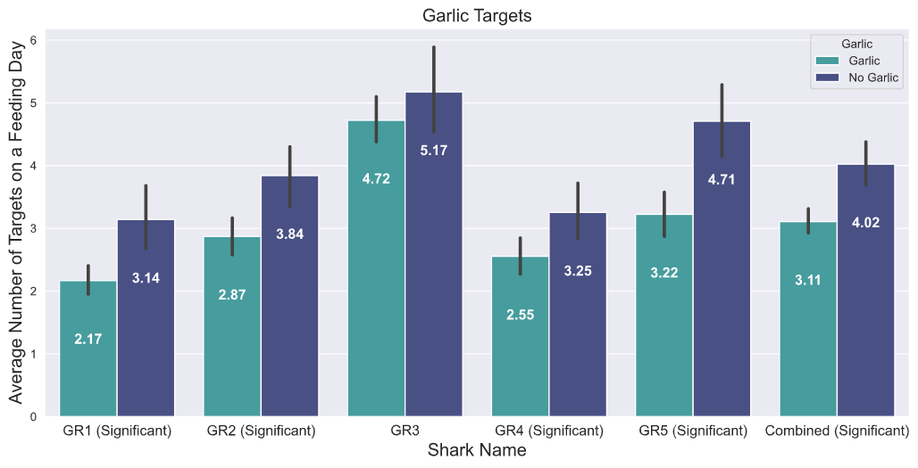
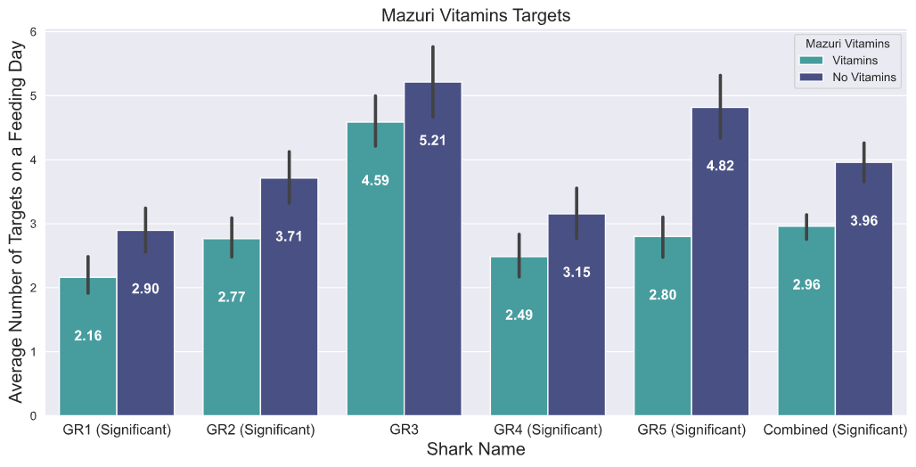
Gray Reef Targeting Patterns
Once again, it is hard to distinguish exactly what causes the Gray Reef Sharks to target more, but we could tell that they do target more when they are fed separately, no garlic is present, and no vitamins are present as well.
GR3 was the only shark whose targeting rate was not significantly affected by any of these factors.
Note: Significant under a group means that the averages were significantly different in a statistical t-test.

Slide 23
Individual Gray Reef Feeding Summary
GR1 -
Favorite Food: Herring
Eats and Targets more when fed separately without garlic or vitamins in the food.
GR2 -
Favorite Food: Herring
Eats and Targets more when fed separately without garlic or vitamins in the food.
Drops more food when being fed separately
GR3 -
Favorite Food: Herring
Drops more food when being fed with all the sharks
GR4 -
Favorite Food: Herring
Eats and Targets more when fed separately without garlic or vitamins in the food.
GR5 -
Favorite Food: Herring
Eats and Targets more when fed separately without garlic or vitamins in the food.

Slide 24
Ross and Chandler

Slide 25
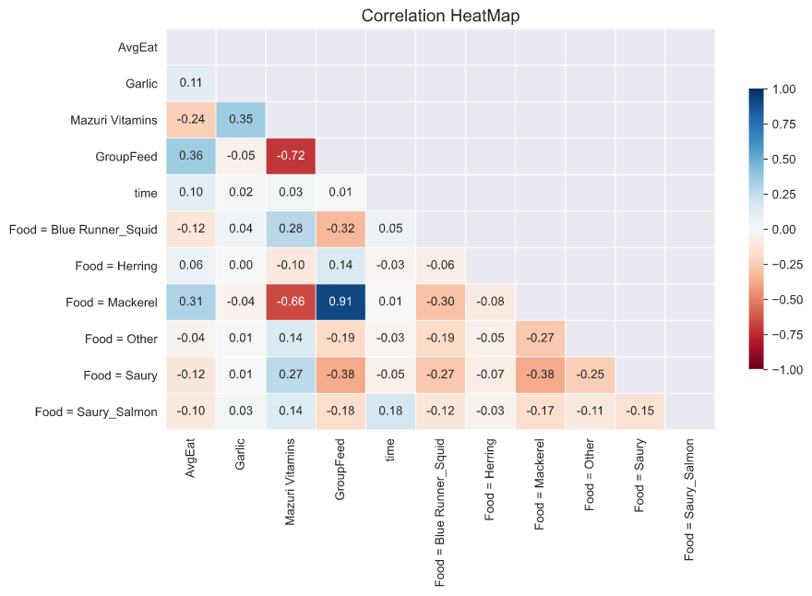
Sand Bar
This Matrix shows how inter-related the variables were when analyzing the Sand Bar’s feeding Trends.
The scale is from -1 to 1. The darker the box the more related the two variables were.
For example, Group Feeding and Vitamins have a strong negative correlation. Meaning that most of the time when they were fed together (0), they were also fed vitamins (1).

Slide 26
Ross vs Chandler Avg Food per Instance (Top 3 Food Combos)

Slide 27
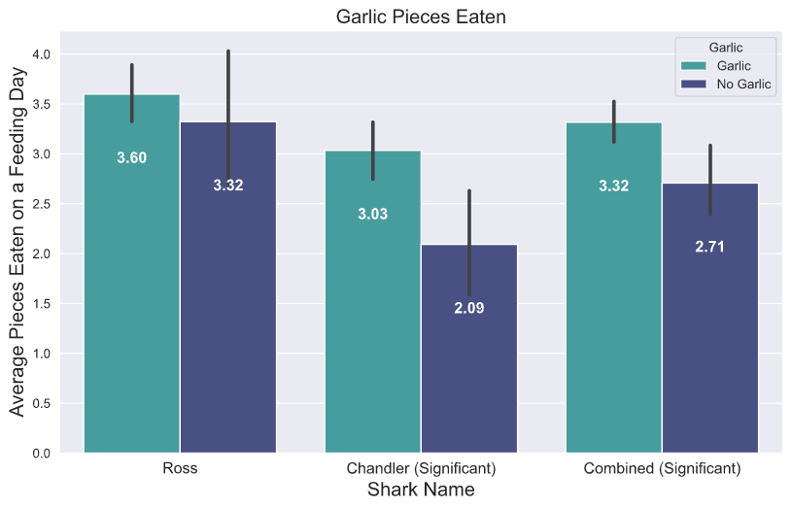
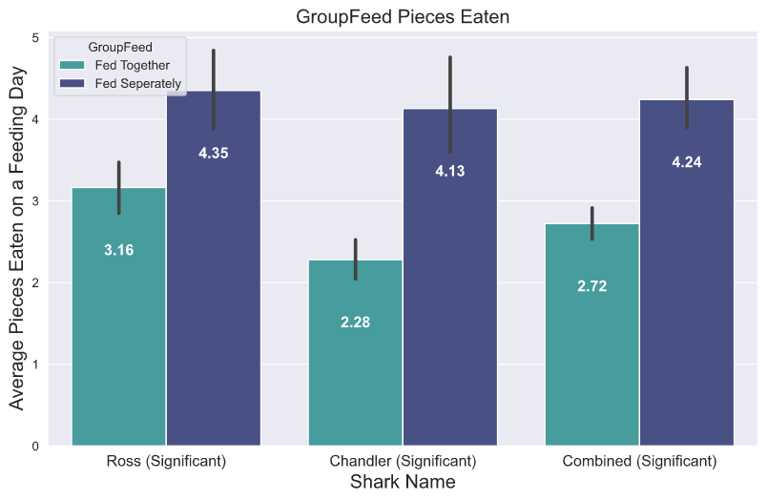
Sand Bar Eating Patterns
The graphs show that Chandler like Garlic more than Ross. He almost always tends to eat more when there is Garlic.
Both Ross and Chandler strongly prefer to be fed separately They Eat on average 2 pieces more of food on these days.
They also prefer not having vitamins in their food, although that is highly related with eating alone. (Graph in Appendix)
Note: Significant under a group means that the averages were significantly different in a statistical t-test.

Slide 28
Sand Bar Dropping Patterns
Garlic, Mazuri Vitamins, and Group Feeding had no significant effect on how many pieces Ross and Chandler Dropped. (Graphs in Appendix)

Slide 29
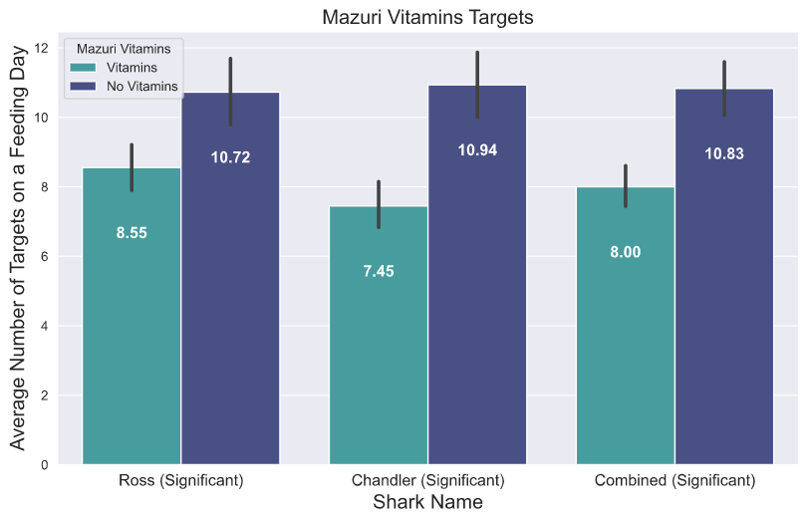
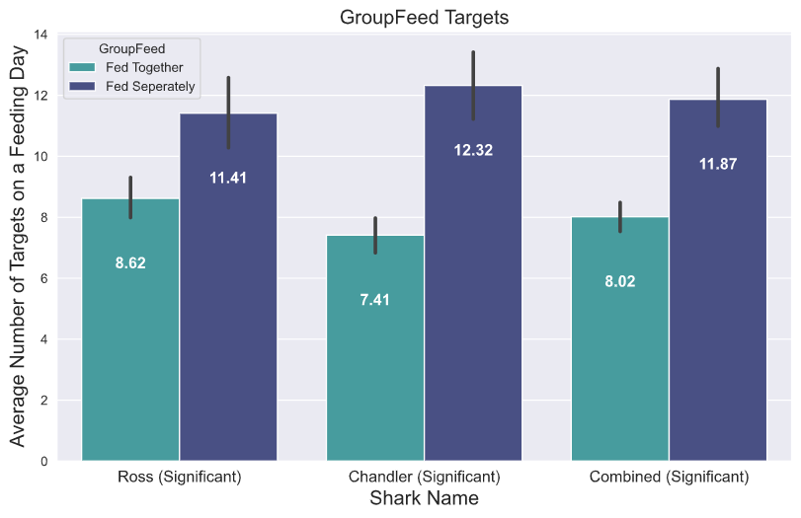
Sand Bar Targeting Patterns
Both Ross and Chandler Targeted more when they were being fed separately and there were no vitamins present.
Note: Significant under a group means that the averages were significantly different in a statistical t-test.

Slide 30
Individual Sand Bar Feeding Summary
Ross -
Favorite Food: Mackerel with Garlic
Eats and targets more when being fed without the Gray Reef Sharks
Chandler -
Favorite Food: Mackerel with Garlic
Loves Garlic
Eats and targets more when being fed without the Gray Reef Sharks

Slide 31
Female vs Male Avg Food per Instance (Top 3 Food Combos)

Slide 32
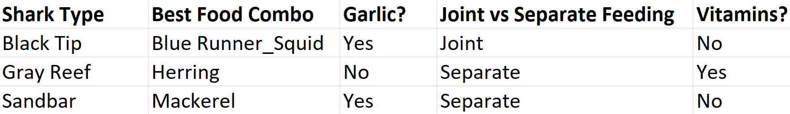
Optimal Feeding for Each Shark Group

Slide 33
Appendix

Slide 34
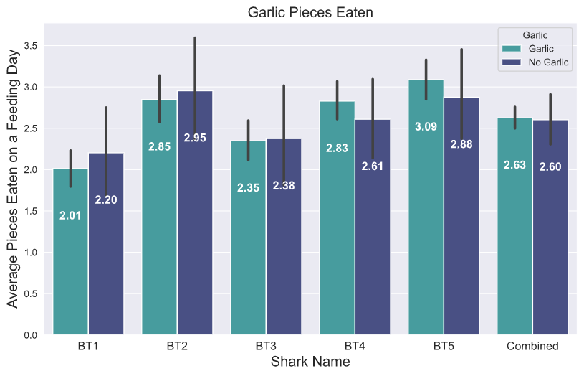
Graph of Garlic and Black Tip Eating Patterns

Slide 35
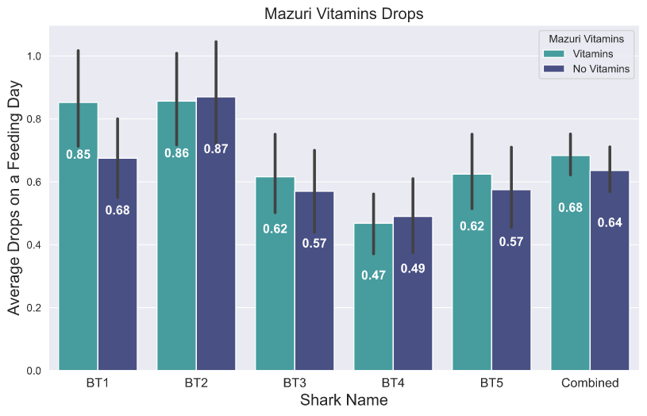
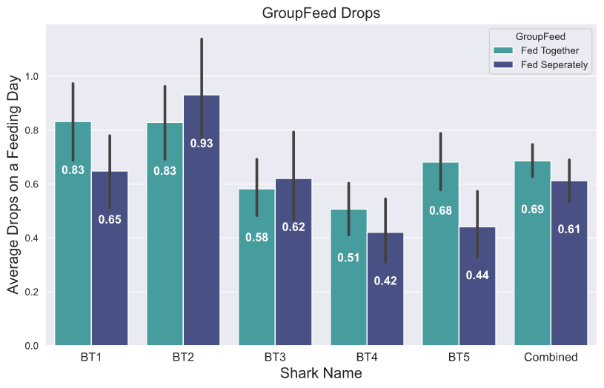
Graph of Vitamins and Group Feeding: Black Tip Dropping Patterns

Slide 36
Ross
Eat/Target Percentage Trends
Drop/Target Percentage Trends
Average Pieces Eaten Trends
Targeting Trends

Slide 37
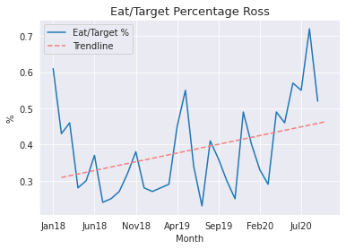
Ross – Eat/Target Percentage
This chart shows Ross’s eat percentage per month for all of the data range. Eat percentage is number of eats / number of targets.
Ross has generally increased his eat percentage, meaning in early 2018, he was eating on 30% of his targets, and as of September he was up to 48% (according to the trendline). This could be due to the spike in July 2020.

Slide 38
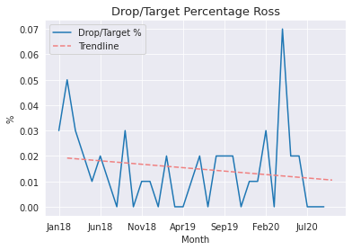
Ross – Drop/Target Percentage
This chart shows Ross’s drop percentage per month for all of the data range. Drop percentage is number of drops / number of targets.
Ross has generally decreased his drop percentage, meaning nearly all his targets result in either a “eat” or just “target”.

Slide 39
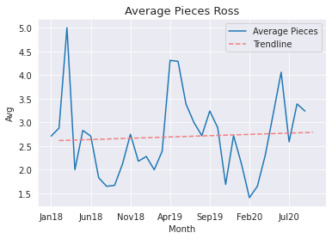
Ross – Average Pieces
This chart shows Ross’s average pieces eaten per feeding on a month to month basis.
Ross has experienced some variability with spikes and dips depending on the month.

Slide 40
Chandler
Eat/Target Percentage Trends
Drop/Target Percentage Trends
Average Pieces Eaten Trends
Targeting Trends

Slide 41
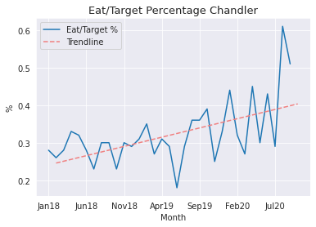
Chandler – Eat/Target Percentage
This chart shows Chandler’s eat percentage per month for all of the data range. Eat percentage is number of eats / number of targets.
Chandler has generally increased his eat percentage, meaning in early 2018, he was eating on 25% of his targets, and as of September he was up to 40% (according to the trendline). This could be due to the spike in July 2020.

Slide 42
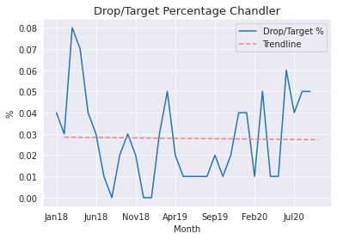
Chandler – Drop/Target Percentage
This chart shows Chandler’s drop percentage per month for all of the data range. Drop percentage is number of drops / number of targets.
Chandler has generally trended on the 3% line, meaning usually 3% of his targets result in a drop.

Slide 43
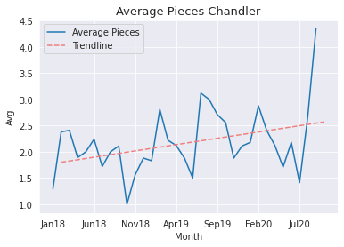
Chandler – Average Pieces
This chart shows Chandler’s average pieces eaten per feeding on a month to month basis.
Chandler has experienced some variability with spikes and dips depending on the month, but has generally increased average pieces eaten overall.

Slide 44
Blacktips

Slide 45
BT1
Eat/Target Percentage Trends
Drop/Target Percentage Trends
Average Pieces Eaten Trends
Targeting Trends

Slide 46
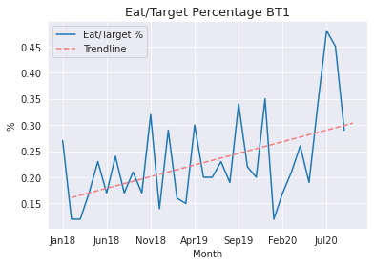
BT1 – Eat/Target Percentage
This chart shows BT1’s eat percentage per month for all of the data range. Eat percentage is number of eats / number of targets.
BT1 has generally increased eat percentage, meaning in early 2018, it was eating on 16% of all targets, and as of September was up to 30% (according to the trendline). This could be due to the spike in July 2020.

Slide 47
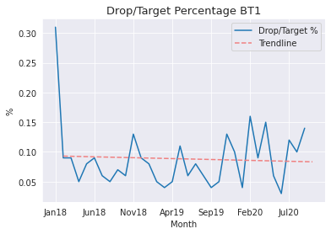
BT1 – Drop/Target Percentage
This chart shows BT1’s drop percentage per month for all of the data range. Drop percentage is number of drops / number of targets.
BT1 had a large number of drops in January 2018, but has decreased since then to be around 10% (according to the trend line)

Slide 48
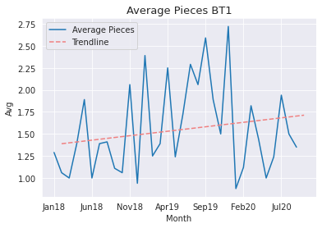
BT1 – Average Pieces
This chart shows BT1’s average pieces eaten per feeding on a month to month basis.
BT1 has primarily experienced great variability on a month to month basis, with a general upward trend.

Slide 49
BT2
Eat/Target Percentage Trends
Drop/Target Percentage Trends
Average Pieces Eaten Trends
Targeting Trends

Slide 50
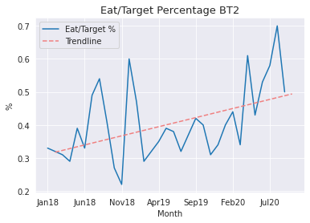
BT2 – Eat/Target Percentage
This chart shows BT2’s eat percentage per month for all of the data range. Eat percentage is number of eats / number of targets.
BT2 has generally increased eat percentage, meaning in early 2018, it was eating on 32% of all targets, and as of September was up to 50% (according to the trendline). This could be due to the spike in July 2020.

Slide 51
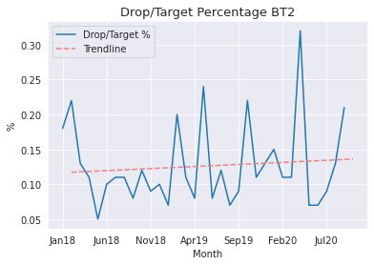
BT2 – Drop/Target Percentage
This chart shows BT2’s drop percentage per month for all of the data range. Drop percentage is number of drops / number of targets.
BT2 experience a sharp spike in April 2020, dropping nearly on 30% of targets.

Slide 52
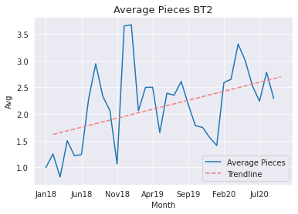
BT2 – Average Pieces
This chart shows BT2’s average pieces eaten per feeding on a month to month basis.
BT2 has experienced a general upward trend, increasing nearly 1 whole piece according the trendline from January 2018 to now.

Slide 53
BT3
Eat/Target Percentage Trends
Drop/Target Percentage Trends
Average Pieces Eaten Trends
Targeting Trends

Slide 54
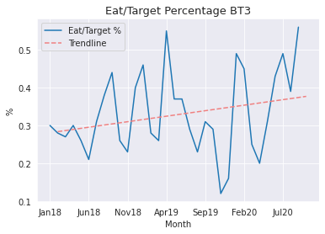
BT3 – Eat/Target Percentage
This chart shows BT3’s eat percentage per month for all of the data range. Eat percentage is number of eats / number of targets.
BT3 has generally increased eat percentage, meaning in early 2018, but has seen much variability in spikes and sudden decreased over the period of a few months.

Slide 55
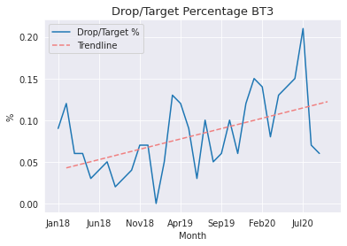
BT3 – Drop/Target Percentage
This chart shows BT3’s drop percentage per month for all of the data range. Drop percentage is number of drops / number of targets.
BT3 has recently been trending upward on drop percentage, and experienced a spike to 22% in July 2020.

Slide 56
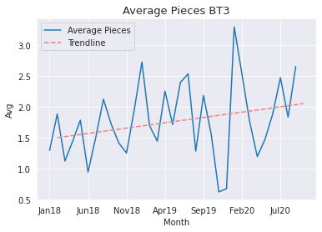
BT3 – Average Pieces
This chart shows BT3’s average pieces eaten per feeding on a month to month basis.
BT3 is usually experiencing a lot of variability month to month, with especially low values in November and December of 2019.

Slide 57
BT4
Eat/Target Percentage Trends
Drop/Target Percentage Trends
Average Pieces Eaten Trends
Targeting Trends

Slide 58
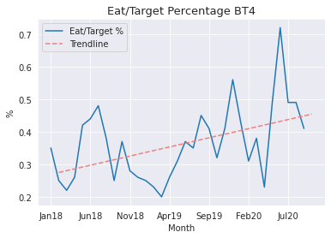
BT4 – Eat/Target Percentage
This chart shows BT4’s eat percentage per month for all of the data range. Eat percentage is number of eats / number of targets.
BT4 has generally increased eat percentage, meaning in early 2018, it was eating on 28% of all targets, and as of September was up to 45% (according to the trendline). This could be due to the spike in July 2020.

Slide 59
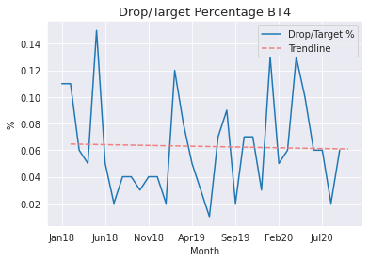
BT4 – Drop/Target Percentage
This chart shows BT4’s drop percentage per month for all of the data range. Drop percentage is number of drops / number of targets.
Although BT4 has experienced spikes, the trend line has remained relative stable at 6%.

Slide 60
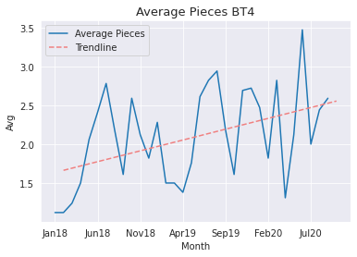
BT4 – Average Pieces
This chart shows BT4’s average pieces eaten per feeding on a month to month basis.
BT4 has experienced a general upward trend, increasing average pieces by 1 whole piece (according to the trend line).

Slide 61
BT5
Eat/Target Percentage Trends
Drop/Target Percentage Trends
Average Pieces Eaten Trends
Targeting Trends

Slide 62
BT5 – Eat/Target Percentage
This chart shows BT5’s eat percentage per month for all of the data range. Eat percentage is number of eats / number of targets.
BT5 has generally increased eat percentage, meaning in early 2018, it was eating on 16% of all targets, and as of September was up to 31% (according to the trendline). This could be due to the spike in July 2020.

Slide 63
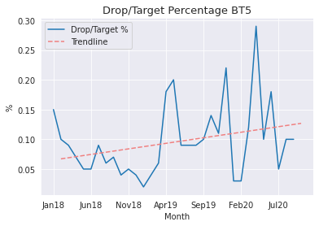
BT5 – Drop/Target Percentage
This chart shows BT5’s drop percentage per month for all of the data range. Drop percentage is number of drops / number of targets.
BT5 has trended upward recently, experiencing a spike in drops in April 2020.

Slide 64
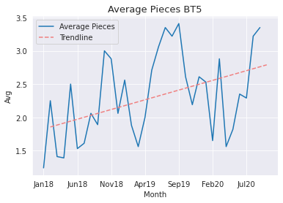
BT5 – Average Pieces
This chart shows BT5’s average pieces eaten per feeding on a month to month basis.
BT5 has experienced an upward trend as well, increasing the average pieces eaten per feeding by month.

Slide 65
Gray Reef

Slide 66
GR1
Eat/Target Percentage Trends
Drop/Target Percentage Trends
Average Pieces Eaten Trends
Targeting Trends

Slide 67
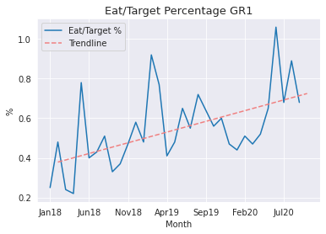
GR1 – Eat/Target Percentage
This chart shows GR1’s eat percentage per month for all of the data range. Eat percentage is number of eats / number of targets.
GR1 has generally increased eat percentage, meaning in early 2018, it was eating on 40% of all targets, and as of September was up to 76% (according to the trendline).
**Note the unusual value in June 2020. Upon reviewing the data, there were no targets recorded for GR1 that month. This seems to be a data recording error.

Slide 68
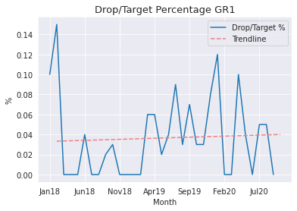
GR1 – Drop/Target Percentage
This chart shows GR1’s drop percentage per month for all of the data range. Drop percentage is number of drops / number of targets.
GR1 experienced a spike in February 2018, but has remained relatively low since then, with some variability month to month.

Slide 69
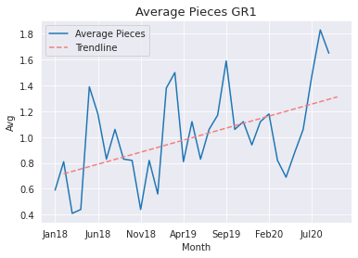
GR1 – Average Pieces
This chart shows GR1’s average pieces eaten per feeding on a month to month basis.
GR1 has experienced some variability with spikes and dips depending on the month, but has generally increased average pieces eaten overall.

Slide 70
GR2
Eat/Target Percentage Trends
Drop/Target Percentage Trends
Average Pieces Eaten Trends
Targeting Trends

Slide 71
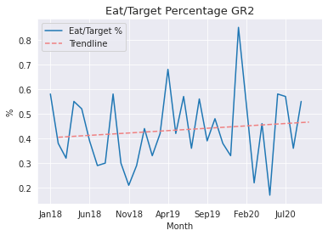
GR2 – Eat/Target Percentage
This chart shows GR2’s eat percentage per month for all of the data range. Eat percentage is number of eats / number of targets.
GR2 has generally been eating on about 40% of targets. GR2 experienced a very high spike in January 2020.

Slide 72

GR2 – Drop/Target Percentage
This chart shows GR2’s drop percentage per month for all of the data range. Drop percentage is number of drops / number of targets.
GR2 has trended up recently with a spike in June 2020.

Slide 73

GR2 – Average Pieces
This chart shows GR2’s average pieces eaten per feeding on a month to month basis.
GR2 has experienced some variability with spikes and dips depending on the month, and had exceptionally low average pieces in May 2020.

Slide 74
GR3
Eat/Target Percentage Trends
Drop/Target Percentage Trends
Average Pieces Eaten Trends
Targeting Trends

Slide 75

GR3 – Eat/Target Percentage
This chart shows GR3’s eat percentage per month for all of the data range. Eat percentage is number of eats / number of targets.
GR3 has generally increased eat percentage, and experienced a very sharp spike in December 2018.

Slide 76

GR3 – Drop/Target Percentage
This chart shows GR3’s drop percentage per month for all of the data range. Drop percentage is number of drops / number of targets.
GR3 has generally trended low in drops, but has some variability month to month.

Slide 77

GR3 – Average Pieces
This chart shows GR3’s average pieces eaten per feeding on a month to month basis.
GR3 has experienced some variability with spikes and dips depending on the month, and recorded very low average pieces in May 2020.

Slide 78
GR4
Eat/Target Percentage Trends
Drop/Target Percentage Trends
Average Pieces Eaten Trends
Targeting Trends

Slide 79

GR4 – Eat/Target Percentage
This chart shows GR4’s eat percentage per month for all of the data range. Eat percentage is number of eats / number of targets.
GR4 has had lots of variability in its eating percentage.
**Note the extreme values in January 2019 and June 2019. There appears to be data descrepencies once again.

Slide 80

GR4 – Drop/Target Percentage
This chart shows GR4’s drop percentage per month for all of the data range. Drop percentage is number of drops / number of targets.
GR4 has recently trended upwards, with a spike in June 2020.

Slide 81

GR4 – Average Pieces
This chart shows GR4’s average pieces eaten per feeding on a month to month basis.
GR4 has experienced some variability with spikes and dips depending on the month, and experienced very low values in June 2020.

Slide 82
GR5
Eat/Target Percentage Trends
Drop/Target Percentage Trends
Average Pieces Eaten Trends
Targeting Trends

Slide 83

GR5 – Eat/Target Percentage
This chart shows GR5’s eat percentage per month for all of the data range. Eat percentage is number of eats / number of targets.
GR5 has recorded a similar amount of eating percentages (according to the trend line). Experienced a spike in June 2020.
**Note the extreme value in January 2018. After reviewing the data, the shark ate more times than it targeted. This could be a data recording error.

Slide 84

GR5 – Drop/Target Percentage
This chart shows GR5’s drop percentage per month for all of the data range. Drop percentage is number of drops / number of targets.
GR5 has generally trended low, never exceeding 8% on targets resulting in a drop.

Slide 85

GR5 – Average Pieces
This chart shows GR5’s average pieces eaten per feeding on a month to month basis.
GR5 has experienced some variability with spikes and dips depending on the month, and also had some low points in May 2020.

Slide 86
Garlic Targets/Drops Vitamins Targets/Drops Group vs Joint Feeding Targets/Drops
All Sharks

Slide 87


Slide 88


Slide 89


Slide 90


Slide 91


Slide 92


